Slide 1

Review of Quantitative Marketing Research

Slide 2
Agenda for Today
Measurement (Scales)
Starting point of all quantitative analysis
Discrete scale Vs. Continuous scale
Discrete Analysis: E.g., CrossTab
Continuous Analysis: E.g., Correlation

Slide 3
MKT 591: Course Roadmap
Review of Quant Market Research
Prediction / Regression
Forecasting
Features & Dimensions
Market Segmentation
Simple Linear Regression
Demand Forecasting
Customer Classification
Factor Analysis
Segmentation Basic
Measurement Scales
Categorical Variables
BASS Diffusion Model
Discriminant Analysis
MDS
Advanced Model-based Segmentation
Discrete Analysis (CrossTab)
Extracting Features by Text Analytics
Multiple Regression
Bayesian Classifier
Spatial Segmentation
Continuous Analysis (Correlation)
Issues in Regression
Tree Models
Intro Deep Learning
Logistic Regression
Intro Bayesian Statistics

Slide 4
Measurement Scales
Quant starts with measurement…

Slide 5
Starting Measurements
Suppose you are a marketing manager in Unilever company. There are potential consumers in the waiting room to participate in your marketing study and one of them is Michael. Let’s think of possible ways to measure the income of Michael.
Three ways to measure Michael’s income
Ask for his exact income (e.g. $87500)
Ask for selecting a range (e.g. ___ less than $25K __ $25K -- $50K __ $50K -- $100K __ more than $100K)
Comparison scales: Michael to the 24 others: assign the person with highest income the number 1, then 2, …., lowest gets 25. Michael gets a XX rank. Any proxy (e.g., car, tax payment, etc.).

Slide 6
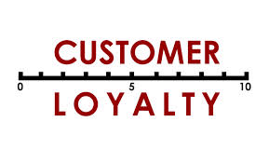
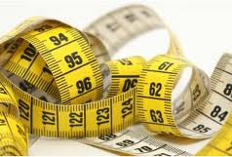
Discussion: Building Customer Loyalty
Unilever wants to understand and measure customer loyalty.
How would you measure “loyalty” among these respondents? In other wards, what questions will you ask to measure the “loyalty”?
Notes:
Purchase frequency, customer satisfaction. Share of wallet, etc.

Slide 7
Measurement Steps
Understand the concept of interest (construct)
Create an operational definition of the concept
Develop the measurement scale(s)
Make sure the scale is reliable and valid
Implement the scales in the field (‘measurement rule’)
* 4 & 5 are not covered this class...
Notes:
Measuring performance is important. We discussed this in our first class…

Slide 8


Step 1: Think about the ‘concept’
Concept: a generalized idea about a class of objects, attributes, occurrences, or processes relevant to the problem.
What you want to measure?
Easy concepts: age, gender, income
Difficult (abstract) concepts: e.g. brand loyalty (attitude, preference, satisfaction, etc.)

Slide 9

Step 2: create an ‘operational definition’
Operational definition: which “observable characteristics” will be measured and the process for assigning a value to the concept → Making a bridge between a theoretical concept and real-world events or factors.
Example 1: to measure ‘gender’, ask for respondents gender
Example 2: How to measure brand loyalty of Toyota???
Notes:
behavioral characteristics, overall satisfaction, and attitudes towards the Hyundai brand.
Find relevant dimensions to measure an abstract construct.

Slide 10
Step 3: Develop Measurement Scales
Primary
Scales
Nominal
Scale
Ratio
Scale
Ordinal
Scale
Interval
Scale

Slide 11
Scale type 1: nominal scale
Represent labels for identification or classification.
Categorized Observations
No order importance
E.g. gender-scale: 1=Man, 2=Female, or
Brand choice: Brand A, Brand B, Brand C, etc.
Other examples
common: Yes/No, hair color, race
marketing: package type, product color
Notes:
identification or classification

Slide 12

Scale type 2: ordinal scale
Numbers from an ordinal scale represent an order
can determine whether an object has more or less of a characteristic than some other object, but NOT how much more or less (Don’t know the amount of difference…)
E.g. tournament ranking scale: 1=Winner, 2 = 2nd place, 3=3rd place,…
Any other Examples?
How about Online Star Rating???
Notes:
Common: quality rankings, class grades (A, B, C etc).
Marketing: preference ranking.

Slide 13
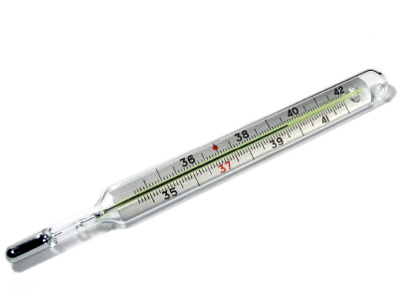
Scale type 3: interval scale
Numbers from an interval scale has a classification and an order + the equal intervals between points on the scales…
Both the zero point and the units of measurement are arbitrary (‘chosen by the researcher’)
Differences can be compared but not ratios (multiplication): E.g., Cannot say that 64ºF is twice as warm as 32ºF (because of arbitrary zero point).
Examples
common: Fahrenheit scale, IQ scale
marketing: attitude-, satisfaction-scales
How about Online Star Rating???

Slide 14
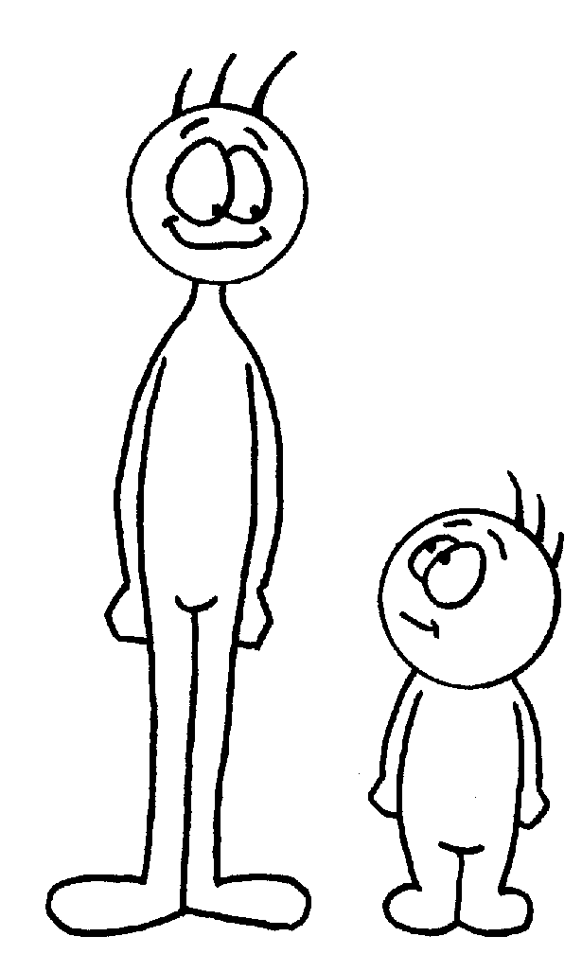
Scale type 4: ratio scale
Possesses all the properties of the nominal, ordinal, and interval scales, plus:
It has an absolute (meaningful) zero point.
The numbers from a ratio scale may be used to compute ratios (multiplying or dividing).
For example, length scale.
Other examples
common: weight, distance, speed
marketing: profit, market shares, sales, income (in exact $)

Slide 15
Four types of scales: in sum…
Note about the four types of scales:
(1) Amount of information increases from nominal to ratio scales (a higher level scale can always be converted into a lower lever scale)
(2) The burden imposed on respondent increases from nominal to ratio scales

Slide 16
Usage Potential of Various Levels of Data
Ratio
Interval
Ordinal
Nested Relationship
Measurement scale impacts the types of analyses that can be applied!
Nominal
Ease of data collection vs. information quality

Slide 17
Data Level, Operations, and Analytics Methods
Data Level | Meaningful Operations | Description
Nominal | Classifying and Counting | Qualitative
Ordinal | All of the above plus Ranking | Qualitative
Interval | All of the above plus Addition, Subtraction, Multiplication, and Division | Quantitative
Ratio | All of the above | Quantitative
Discrete
Continuous

Slide 18
Two representative measurements
Discrete measurements
Nominal Scale and Ordinal Scale
Representative analyses: Frequency analysis, Cross Tab
Useful for choice analysis in Marketing: E.g., Discrete Regression such as Logistic/Probit Regression or Ordinal Regression.
Continuous measurement
Interval Scale and Ratio Scale
Representative Analysis: Descriptive statistics (e.g., Mean and Variance), Correlation
Useful for consumer purchase intention or satisfaction analysis in Marketing (e.g., Normal Regression).
One question for you! Which type of measurement is easier for any quantitative analysis?

Slide 19
Discrete Variable Analysis –
CrossTab (One very useful technique)

Slide 20
Intuitive Example of CrossTab
Smart Phone Brand Preference Question to 2000 panel respondents from two different geographical areas: “Which smart phone do you want to buy?” (for simplicity, iPhone 7 and Samsung Galaxy S7)
 | Western | Eastern | Total
iPhone | 500 | 500 | 1000
Galaxy | 500 | 500 | 1000
Total | 1000 | 1000 | 2000
Vs.
 | Western | Eastern | Total
iPhone | 300 | 700 | 1000
Galaxy | 700 | 300 | 1000
Total | 1000 | 1000 | 2000
Which results are independent (no relationship) and which one is not independent (dependent relationship)? Let’s guess!
What can be your marketing implications?
Notes:
For iPhone, defensive strategy to Eastern areas but followers’ aggressive marketing strategy to Western area.

Slide 21
Cross-tabulation (CrossTab)
Joint Frequency distribution based on two or more discrete variables.
A cross-tabulation describes two nominal/ordinal (discrete) variables simultaneously
It is an important and useful technique in Marketing!
Easy to understand and strong link between research results and managerial actions
For test-statistics in hypothesis procedure, we use Chi-Square distribution.
Easy to conduct it with any package software (e.g., R or SPSS)

Slide 22

B-to-B electric utility industry example
Client: A large electric utility company in Texas
Goal: become customer-focused; customer satisfaction became core business principle underlying all business decisions
Q. 1: [Account Size: Ordinal] In the past year, approximately how much did you spend on electricity?
_____ Less than $XX _____ $XX -- $YY _____ More than $YY
(“small accounts”) (“medium accounts”) (“large accounts”)
Q. 2: [Recommendation: Nominal] Based on your professional experience, would you recommend our company to a friend or colleague as a main business supplier for electricity?
_____ Yes _____ No

Slide 23
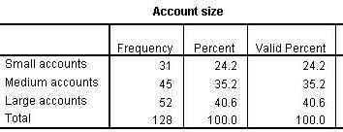
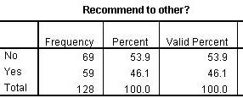
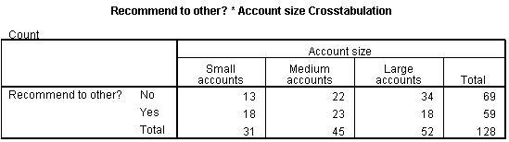
Cross tabulation = freq. table 1 + freq. table 2
Variable: ‘recommend’
Variable: ‘accntsize’
Question B
Question A
COMBINE
How the cross-table is different from the two simple frequency tables?

Slide 24
Let’s do this with R.
Import the CrossTab_Example.csv data into R.
Build frequency tables into R as shown in previous slides.
Let’s build cross tables into R
Is that statistically significant (what does this mean?)
What is your conclusion?
What are your managerial implications?
Let’s do this using package for Cross Tab Analysis.

Slide 25
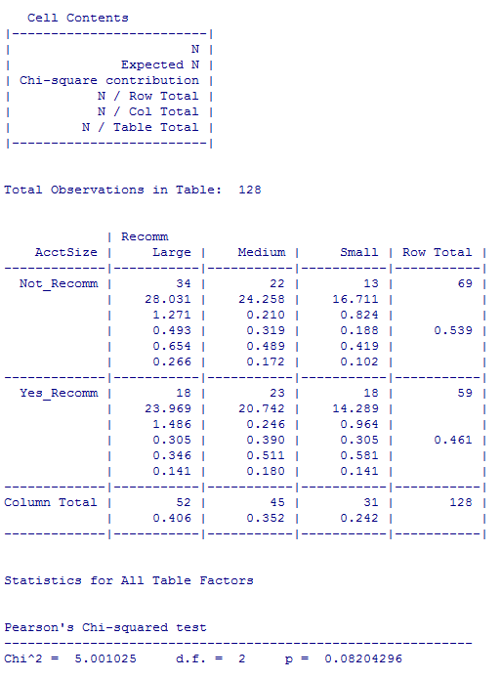
Discussion Questions:
What is the most interesting cell? What is managerial interpretation?
What is statistical testing conclusion?

Slide 26
Let’s understand what is going on behind...
A test-statistic measures how close the sample has come to the null hypothesis.
A well-thought-off test statistic (statistician figure this out) follows chi-square distribution
For testing about relations in a cross-table, you use the Chi- square test-statistic formula as below:
Observed counts for cell i
Expected counts for cell i
when H₀ is true
Basically and intuitively, the formula measures how far observed values are from expected values.

Slide 27
computing E_{i} (Expected Counts)
Dude, are you kidding me?
“Expected counts” represents the status of NO relationship between columns and rows

Slide 28
Step 3: compute a test statistic
Fill out the formula
df = (C-1)(R-1)= (3-1)*1=2

Slide 29
Structure of all kinds of hypothesis testing
All kinds of hypothesis testing have same procedures.
Here, expected counts represent “no relationship” which is null hypothesis!
If the difference (i.e., effect size) is getting large and large… we have higher chance to REJECT the null hypothesis.
It means higher test statistics → small p-value always…

Slide 30
In class practice
Use the Text book Simulation data (see page 364 for data description)
cbc.df<-read.csv("http://goo.gl/5xQObB")
What is relationship between cargo capacity and choice? Statistically significant?
What is relationship between number of seat and choice?

Slide 31
Announcement
1. Project Groups (Random assign or you decide?)
2. Assignment 1
Available from next Thursday (00:01am of 03/21).
Due date will be by the end of next Thursday (11:59pm 03/28).
It will cover CrossTab, Correlation and Regression
3. Please study materials of CrossTab in PPT slides and practice R for CrossTab. Relevant reading material is available in our Blackboard.

Slide 32
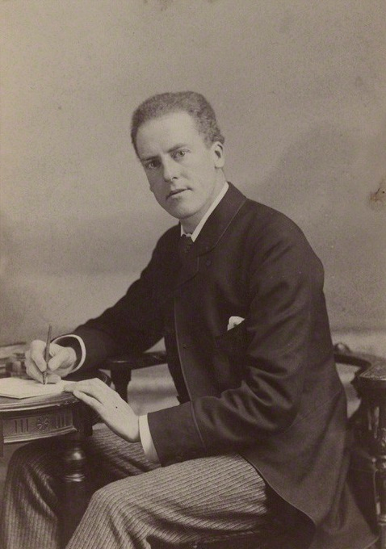
Continuous Variable Analysis – Correlation
Statisticians said the most important innovation in all statistics history…
Karl Pearson

Slide 33
Example – Correlation
Market ID | Price | Sales
1 | 2.5 | 182
2 | 2.5 | 169
3 | 2.7 | 182
4 | 2.8 | 149
5 | 2.3 | 188
6 | 2.2 | 200
7 | 2.7 | 159
8 | 2.0 | 212
9 | 2.8 | 161
10 | 2.6 | 145
11 | 2.7 | 187
12 | 1.9 | 194

Slide 34
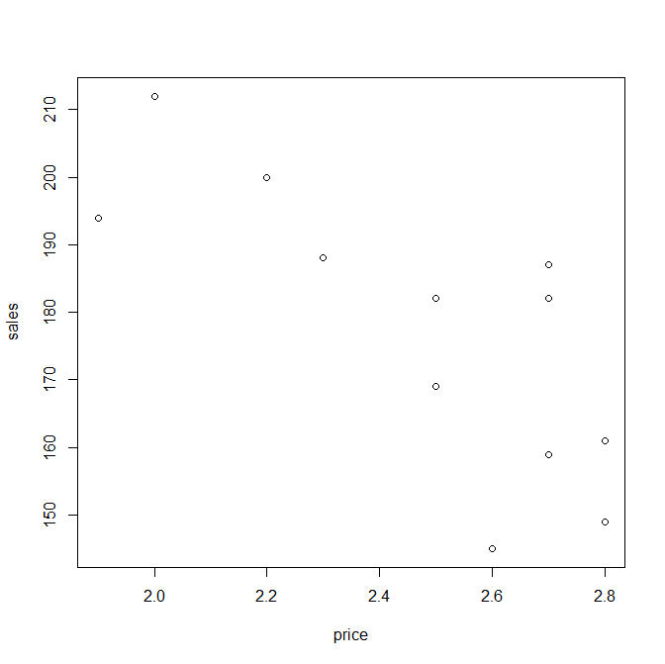
Scatter Plot – Sales Data
Can you see any pattern from this plot?

Slide 35
Pearson Correlation (r_{xy})
Uses two variables, X and Y, that are continuous (interval or ratio scales), and examines whether they are significantly linearly associated.
−1 ≤ r_{xy} ≤ 1
Allows us to calculate one number summary to reflect the level of association between X and Y.
Researchers can first examine scatterplot of X vs. Y to see if any discernable patterns emerge visually – though this is not always precise.
Notes:
25

Slide 36
Hypothesis Testing for Correlation
H0: ρ is equal to 0
Ha: ρ is significantly different from 0
Notes:
Population correlation; sample correlation

Slide 37
Let’s do this in R
Let’s draw scatter plot first.
What is the estimated correlation?
Is this statistically significant?
Let’s use the package.
What is your conclusion?
What is managerial implications?

Slide 38
Pearson Product-Moment Correlation Coefficient
A one number summary of the association between two continuous (metric) variables (varies between –1 and +1).
Notes:
39

Slide 39
Correlations: two warnings
1. Only for a linear relationship between two variables.
Non-linear relationships (regardless of strength) cannot be measured by a correlation coefficient
2. Correlations do NOT mean causation:
… the number of Churches in a city correlates with the number of crimes
… students in a psychology class who had long hair got higher scores on the midterm than those who had short hair
… the correlation between teacher’s salaries and the consumption of liquor over a period of years is 0.9
These kinds of correlations are known as ‘spurious correlations’ or ‘nonsense correlations’

Slide 40
Three Prototypes of Linear Association
Positive correlation: the correlation coefficient is larger than 0
When X increases, Y tends to increase
Higher values of X are associated with higher values of Y
Y
A
r > 0
X
Notes:
40

Slide 41
Three Prototypes of Linear Association
B
Negative correlation: the correlation coefficient is smaller than 0
When X increases, Y tends to decrease
Higher values of X are associated with lower values of Y
Y
r < 0
X
Notes:
40

Slide 42

Three Prototypes of Linear Association
No correlation: the correlation coefficient is (close to) zero
“Knowing X does not help you know anything about Y”
Y
C
r = 0
X
Question for you:
If we find r=0.03 (with p<0.005), is this significant?
If we find r=0.8 (with p=0.2), is this significant?
This point tells us an important concept of statistics…
Notes:
40

Slide 43
LifeStyle Study Data
We will use the data from a questionnaire collected in 1998 by Prof. Putnam at Harvard (http://bowlingalone.com/). It contains information on internet usage, political sensitive topics, and demographics.
Suppose you are the marketing manager of your favorite political party and management team asks you to investigate whether the party should redirect their PR and discussion of sensitive topics to the internet. The internet is an excellent medium to further elaborate on sensitive topics.

Slide 44
In-Class Exercise
Please use LifeStyle Data for this In-Class exercise.
Suppose that management wants to understand possible relationships between following variables: E.g., ‘buyamer’ (i.e., Americans should always try to buy American products), ‘politic’ (i.e., I am interested in politics) and ‘Respondent’s age’.
What is the estimated correlation value?
Can we say that the relationship is significant?
What is your interpretation?

Slide 45
Connection with Regression Model
The process of constructing a mathematical model that can be used to predict one variable (DV) by another variable (IV)

Slide 46
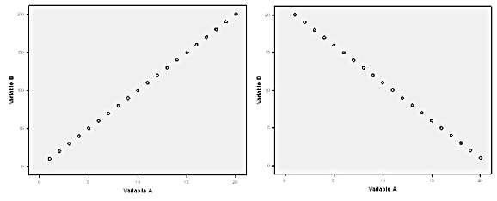
One Hypothetical Example: what if we observed perfect positive correlation or negative correlation in population?
Assuming the perfect positive correlation between Sales and Promotion, how can you predict Sales?
Assuming the perfect negative correlation between Sales and Price, how can you predict Sales?

Slide 47
Sales Data Example (In real world, no perfect correlation in Marketing!)
SALES
PRICE
If we increase our price to $3, what will happen to out sales (best guess)?
Notes:
In real world no perfect correlation… We might have some errors (or unobservables) because of many different factors (advertising, promotions, competitors, etc.)

Slide 48
Example – Sales Data
What we observe from data.
SALES
PRICE
PROMOTION
ADVERTISING
COUPON
DISPLAY
••••••
Many other possible factors which can affect sales.

Slide 49
SALES
PRICE
PROMOTION
We consider all other factors as a random variable.
ADVERTISING
COUPON
DISPLAY
SALES = f ( PRICE, Some other factors )
Two Assumptions of Regression Model
Linear Relationship Between SALES and PRICE
Other factors follow N( )
Notes:
Linear

Slide 50
SALES = f ( PRICE, Other factors )
Assumptions of Regression Model
Linear Relationship Between SALES and PRICE
Other factors follow N( )
i-th market or unit
Dependent Variable
Independent Variable
“coefficients”
“error”

Slide 51
Regression Model
This model specifies the population-level relationship among sales, price, and other factors. → our best guess using the observed data.
To use this model, we should know ____ and ____.
Using sample data, we make inferences on and .
Here, and are parameters.

Slide 52
MKT 591: Course Roadmap
Review of Quant Market Research
Prediction / Regression
Forecasting
Features & Dimensions
Market Segmentation
Simple Linear Regression
Demand Forecasting
Customer Classification
Factor Analysis
Segmentation Basic
Measurement Scales
Categorical Variables
BASS Diffusion Model
Discriminant Analysis
MDS
Advanced Model-based Segmentation
Discrete Analysis (CrossTab)
Extracting Features by Text Analytics
Multiple Regression
Bayesian Classifier
Spatial Segmentation
Continuous Analysis (Correlation)
Issues in Regression
Tree Models
Intro Deep Learning
Logistic Regression
Intro Bayesian Statistics

